Slide 1
Tutorial ADDON ON ODOO (SYSTEM)
Prepared BY: Dennis Wong Chu Ho
DATE: 22/4/2025

Slide 2
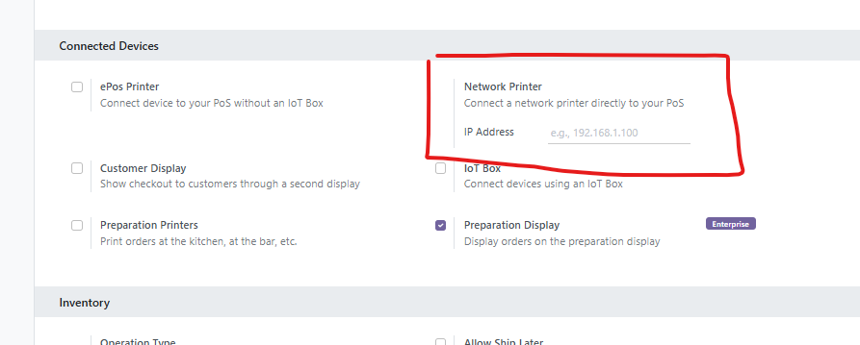
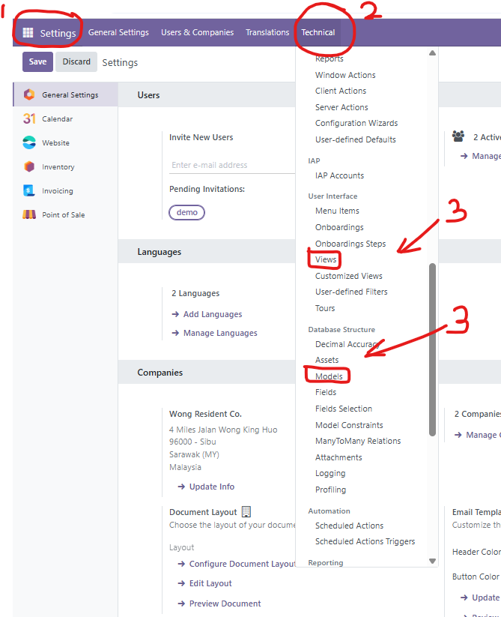
Dear Programmers, I will show you how to make an addon.
As you can see, there are few thing needs to be doing there. Since I’m using odoo version 18
Access to settings -> Technical -> User Interface -> Views
Access to settings -> Database Structure -> Models
Future changes would be addon soon

Slide 3
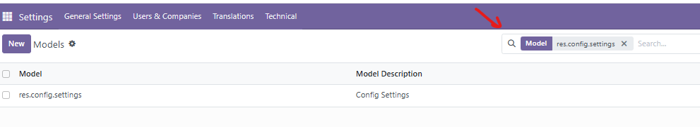
Access to settings -> Database Structure -> Models
From there, make sure to use the search method by finding res.config.settings.
After got this result, select that model to access

Slide 4
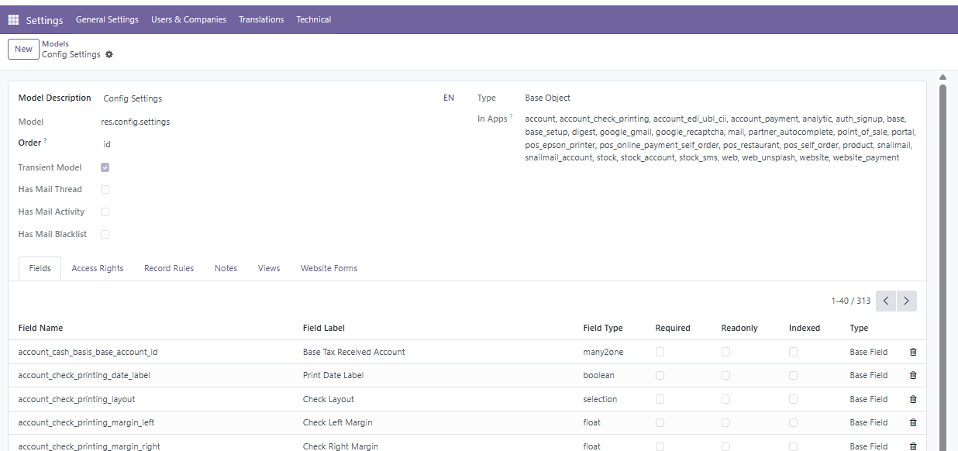
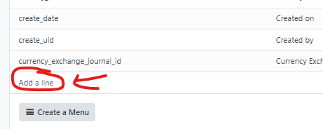
From there, you will eventually see that kind of pages, please add a line to create a new field.

Slide 5
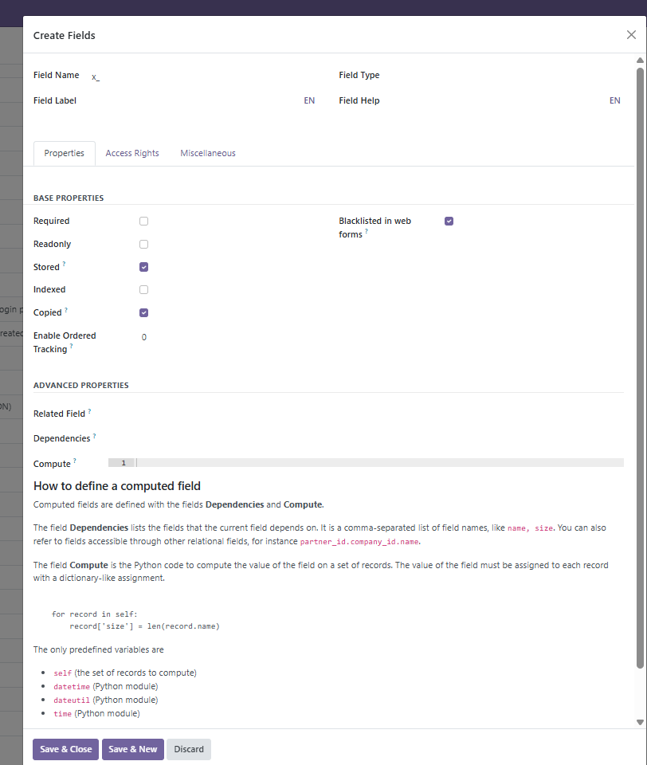
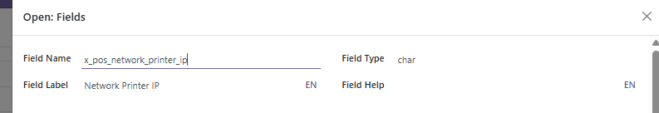
From here, just focus on field name, field type and field label to be filled, the rest just ignore them as those are autofill.
After fill those, please save and close.
This is not over yet as it cannot save at the moment as you have to settle other side, in which im going to show you for the view part.
Bottom picture is an example for filling those but REMEMBER that “x_(filling name)”, in which X_ must be involved as this is conside as custom made, not the base made.

Slide 6
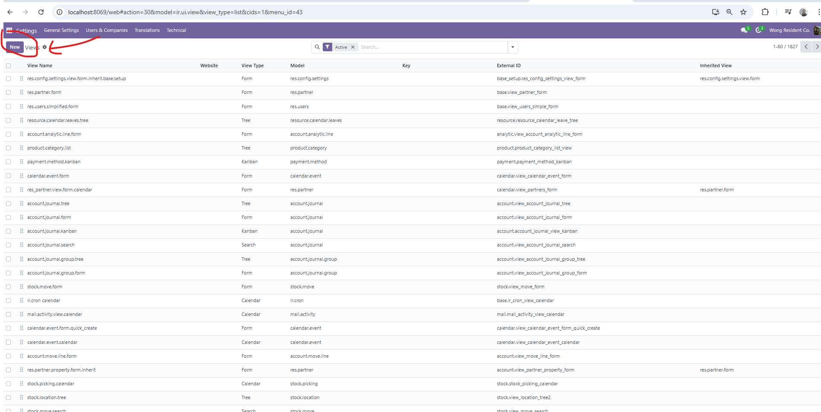
Access to settings -> Technical -> User Interface -> Views
For this session under views. Please make sure to select new one.
Beware that doing an addon, you need to follow the procedure as most of the form I use is under POS system.
res.config.settings.view.form.inherit.point_of_sale
res.config.settings.view.form
Those two, especially view form, do not touch or change it as this is the base. But im going to talk about the inherit point of sales session

Slide 7
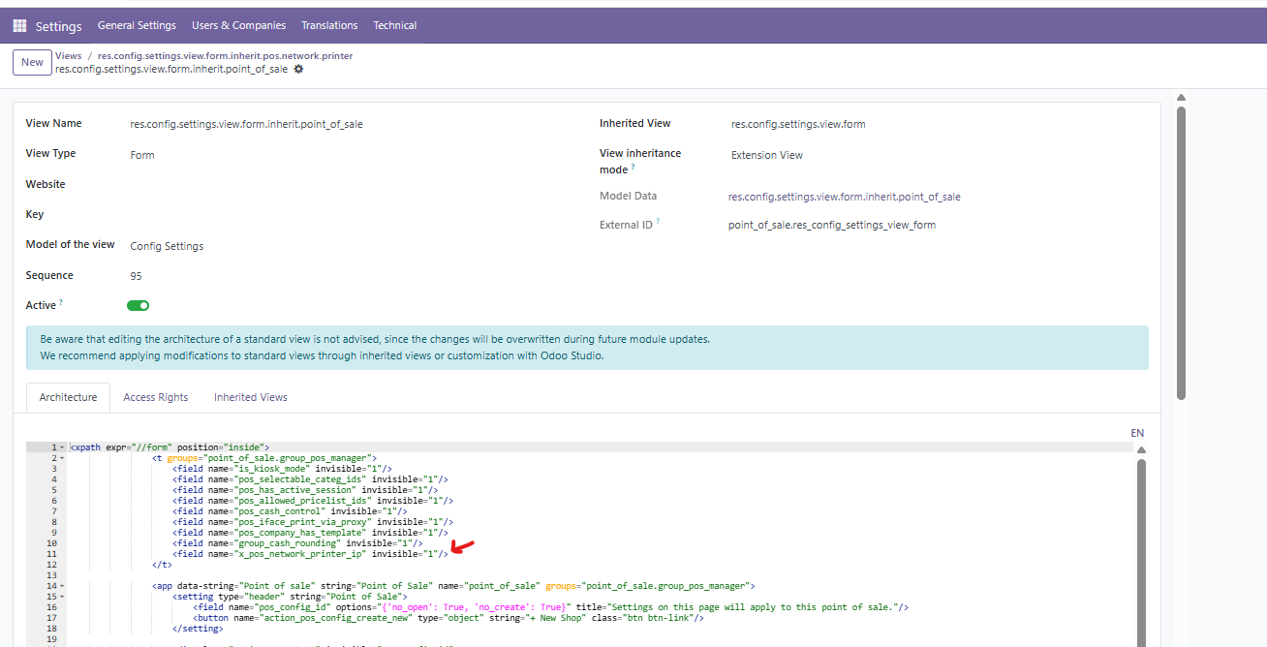
IN this session in point of sale, you don’t have to change anything except you gonna add something here, which is very important.
The arrow shows the field name that I recently add new stuff from the models before, use that one, put into that part because we are using the POS settings.
However, beware that “view name” as we need this one to use under the section of inherited view later so please make sure to copy that part.

Slide 8
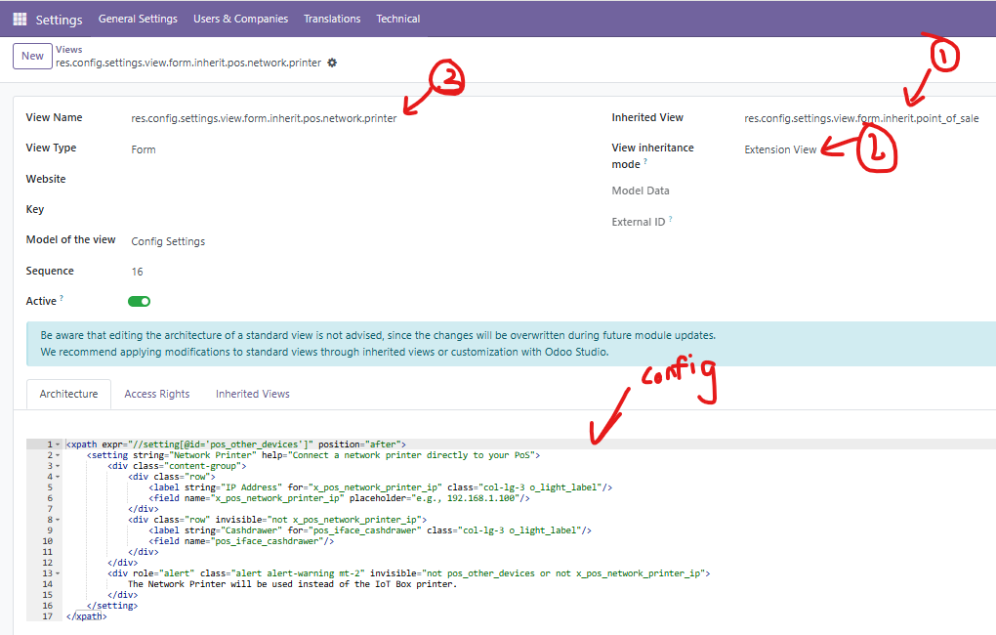
For This part like 1 and 2 shown by arrows given, remember I mention about copy from the point of sale before from the view name? That one is for putting into the inherited view under the new view later.
For view inheritance mode, make sure to select “extension view” as this is an extension after all. This one would mostly used often so don’t forget that part.
For the third part, just add the new name like what I did, after inherit, set something like “pos.example” or anykind would do but make sure to remember it as this would be useful later.
AS for config part, this is an example for configuring the setting by just addon some stuff here.
In the future, I would provide more information as time goes on. Right now when you finish that part, save all for this page including the previous slide POS that filed part and the model part. Cause anything missinh would cause error and wont save unless programmers would do it right.
As the results for this, programmer will see the addon under the section of POS settings, especially I already shown on the second slides though as a results.

Slide 9
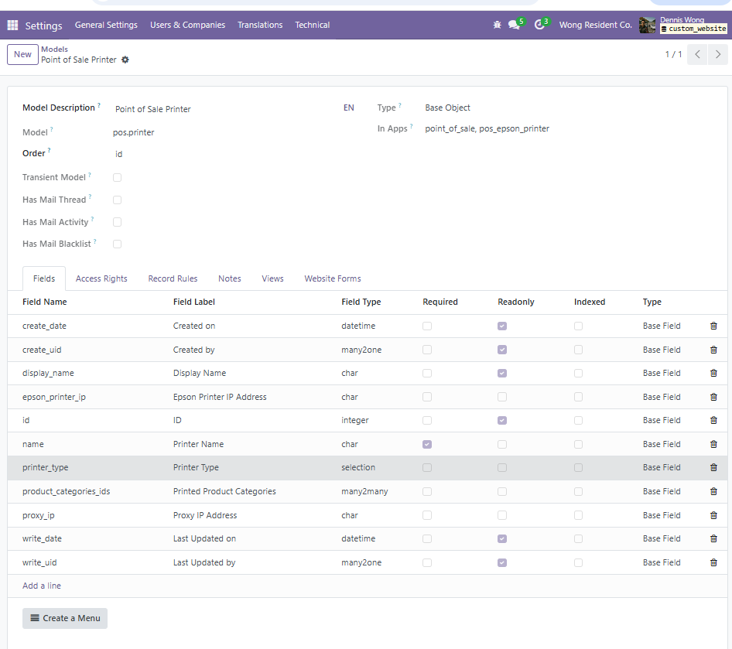
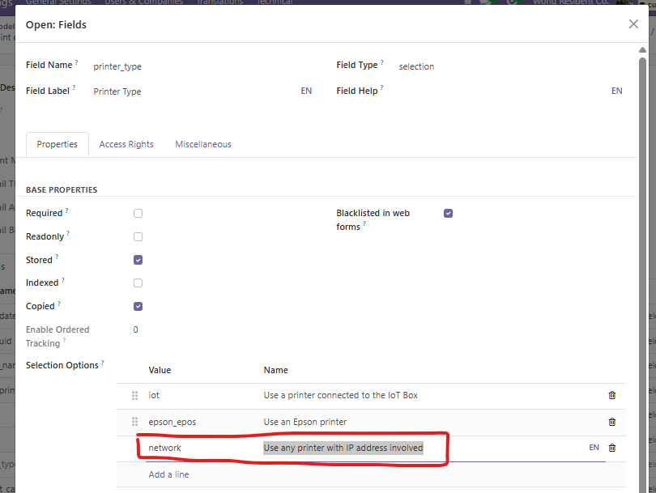
Settings → Technical → Database Structure → Models.
From here, edit the pos.printer and add new
Add value: network
Name: Use network printer (IP address)

Slide 10
Settings → Technical → User Interface → Views

